Slide 1
JAVA Lecture 22
Lambda Expressions

Slide 2
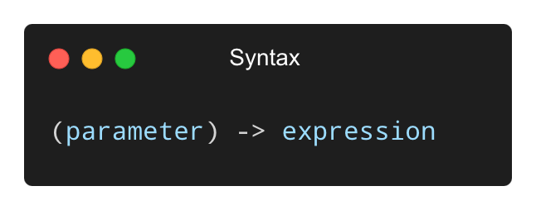
What is a Lambda Expression?
A lambda expression is a short block of code that takes in parameters and returns a value.
Introduced in Java 8 for functional programming.
Replaces anonymous classes used for functional interfaces.

Slide 3
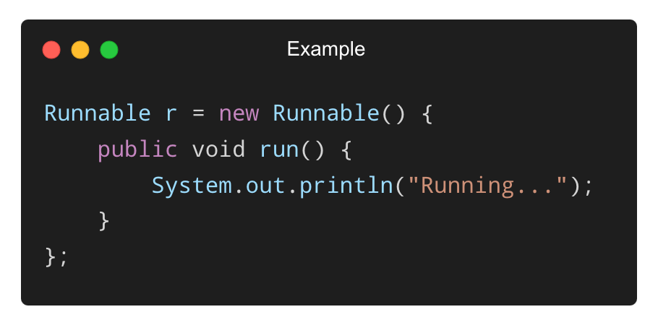
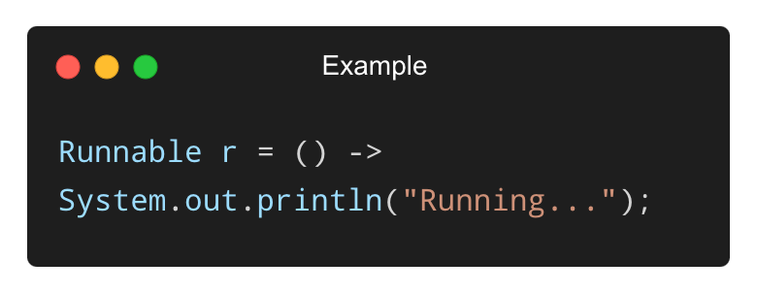
Why Use Lambda Expressions?
✅ Reduces boilerplate code
✅ Makes code cleaner and easier to read
✅ Ideal for callbacks, events, filtering, sorting
✅ Used with functional interfaces
Before Lambda:
With Lambda:

Slide 4
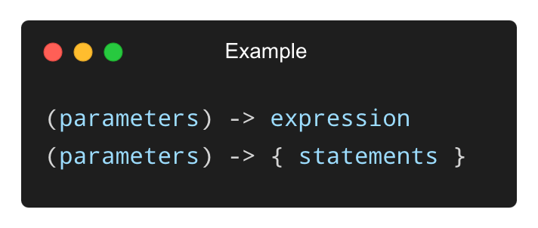
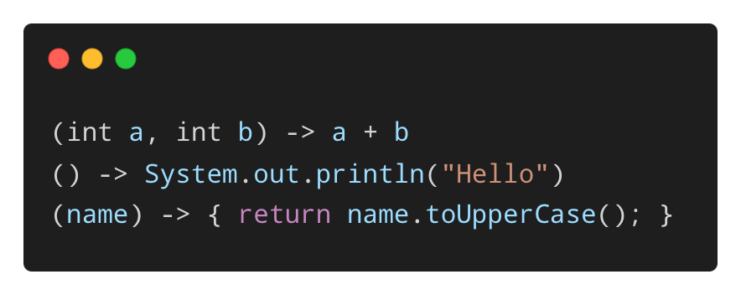
Basic Syntax of Lambda Expressions
General form:
Examples:
✅ Can be single-line or multi-line (block lambda)

Slide 5
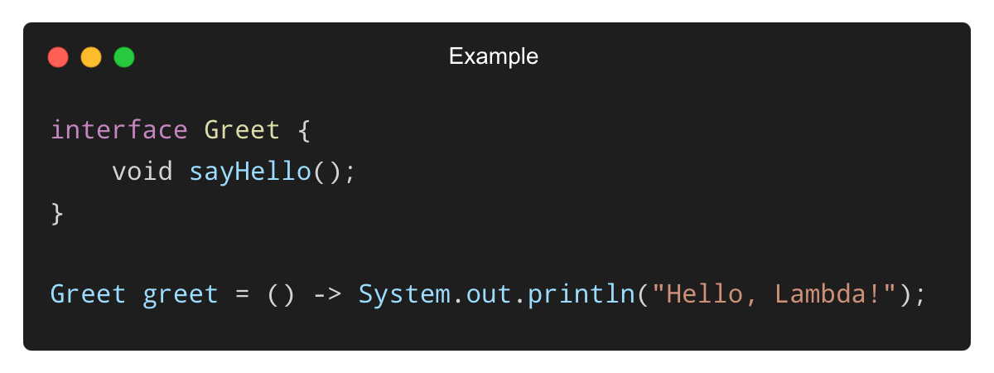
Functional Interfaces and Lambdas
A lambda can only be used where a functional interface is expected.
Functional interface: An interface with only one abstract method.
✅ Common functional interfaces are in java.util.function.

Slide 6
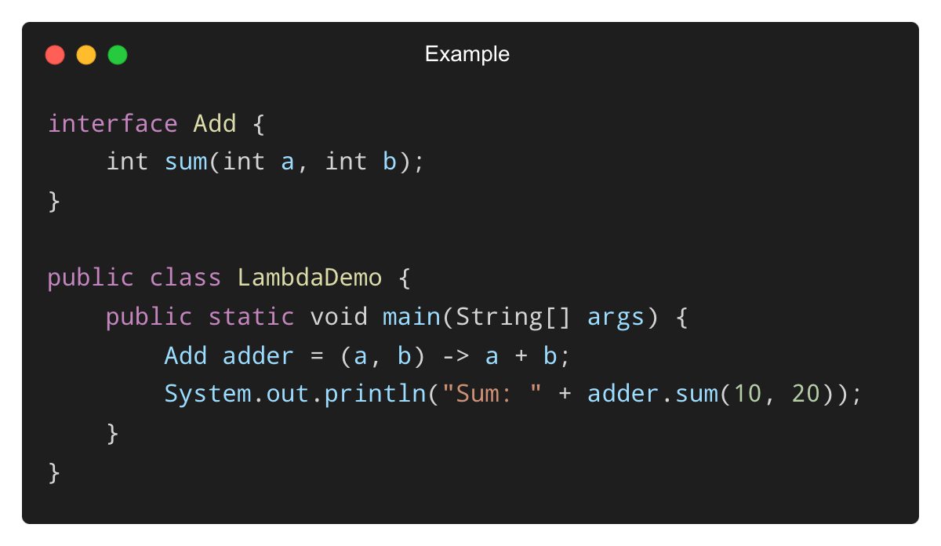
Lambda with Parameters and Return Values
✅ Works like a compact function definition.

Slide 7
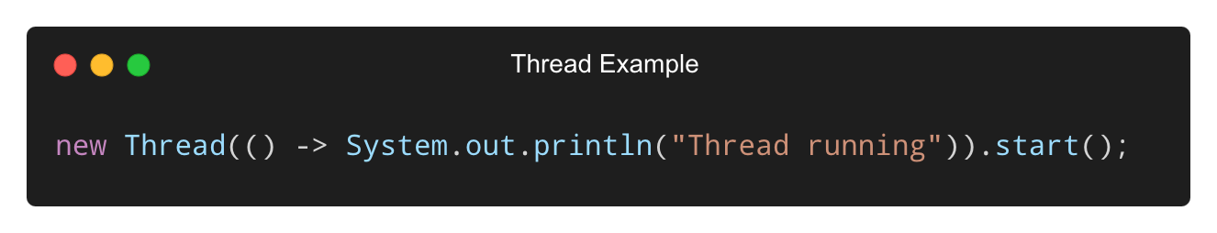
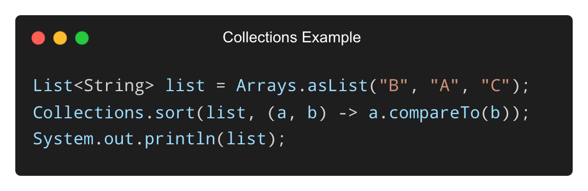
Using Lambdas with Threads and Collections
✅ Perfect for concise, event-driven code.

Slide 8
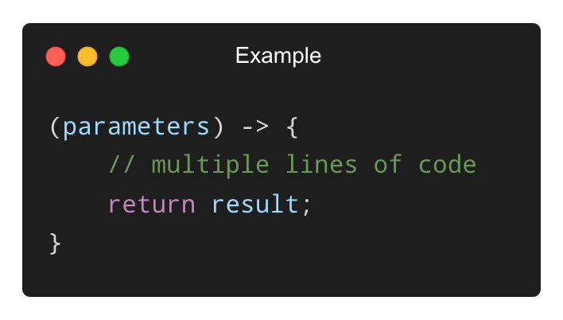
What is a Block Lambda Expression?
A block lambda allows multiple statements inside a lambda body.
Uses curly braces {} and may contain return statements.
✅ Syntax:

Slide 9
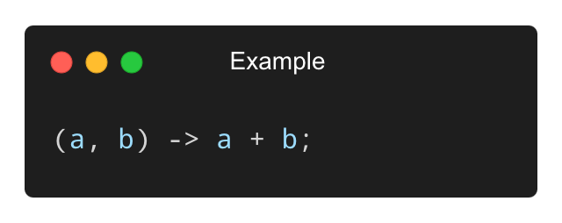
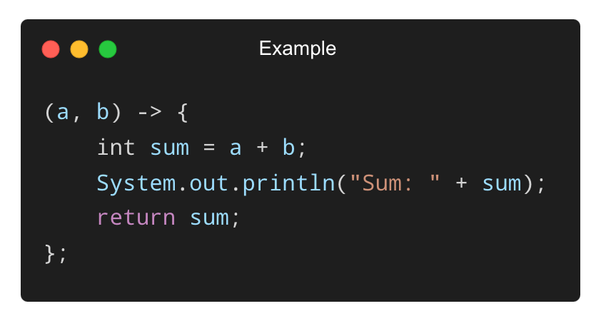
Example – Single vs Block Lambda
Single-Line Lambda:
Block Lambda:
✅ Use block lambdas for complex logic or multiple steps.

Slide 10
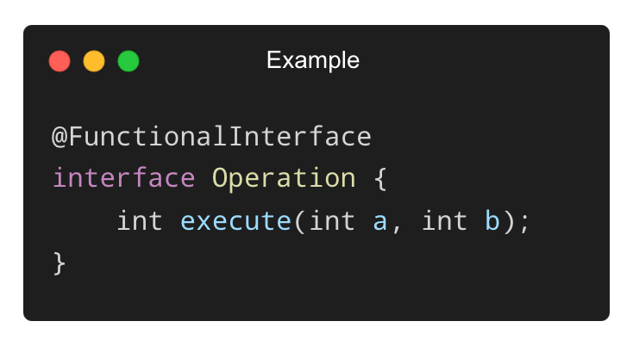
Defining a Functional Interface
✅ This interface can be used to implement any binary operation using lambdas.

Slide 11
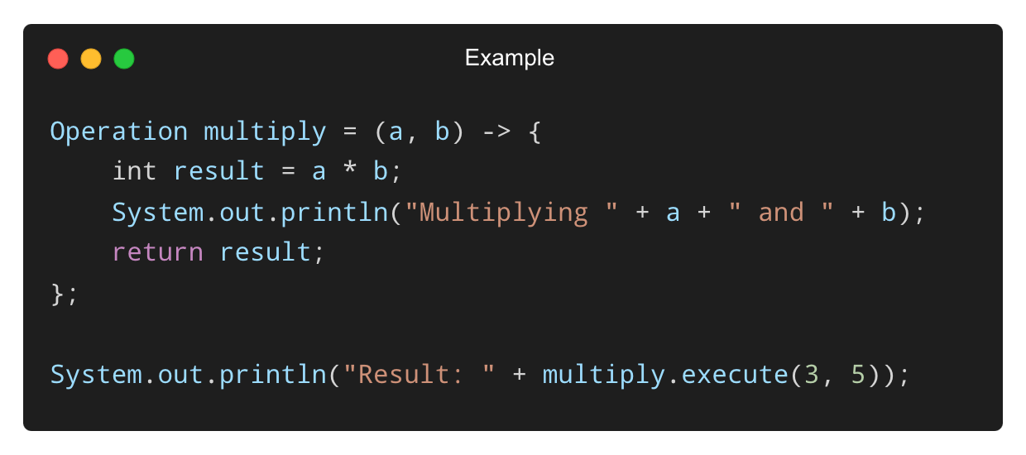
Using Block Lambda with Custom Interface
✅ Block lambdas can contain print statements, loops, conditionals, etc.

Slide 12
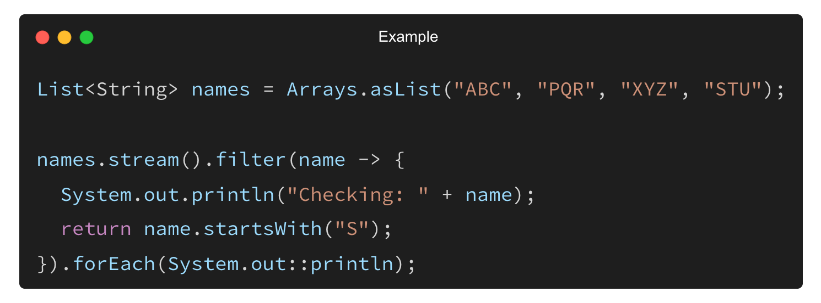
Using Block Lambdas in Java APIs
Lambdas are frequently used with APIs like streams, threads, listeners.
Example – Filtering names:
✅ Streams + block lambdas = readable and powerful processing.

Slide 13
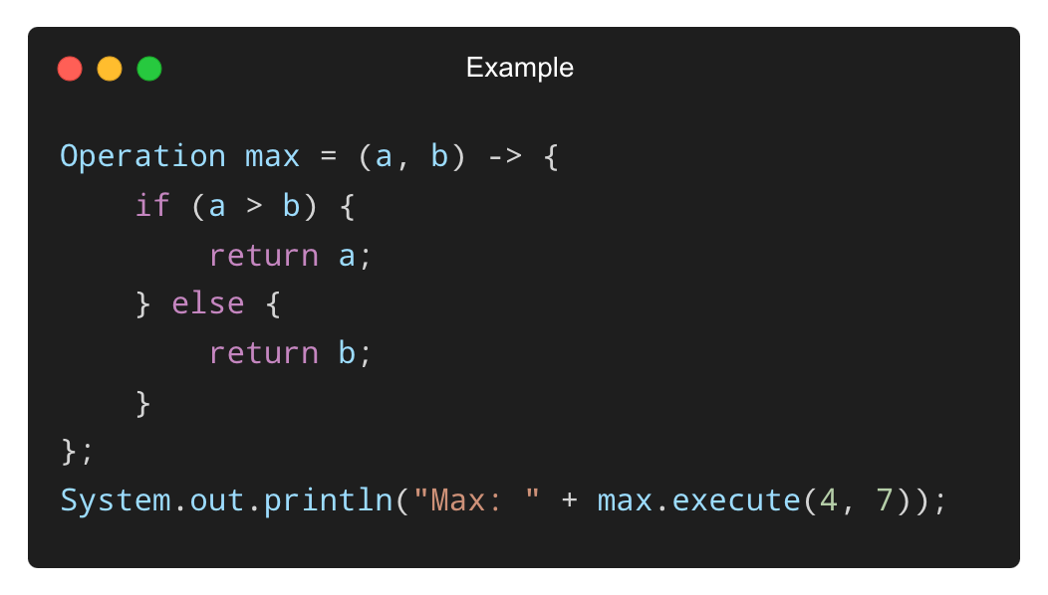
Nested Logic in Block Lambdas
✅ Block lambdas allow conditional logic just like normal methods.

Slide 14
THANK YOU

